Slide 1
Reliability and Validity
Why is this so important and why is this so difficult?

Slide 2
Reliability and Validity
The language for this is from the quantitative tradition—scientific verification—positivism. Habermas’ cognitive interest of control.
In experimental research terminology:
Can we assume that the independent variable is the only cause of change in the dependent variable?

Slide 3
Dependent Variable
The measure of the characteristic of individuals in groups
The study outcome measure
The test score

Slide 4
Independent Variable
The variable that identifies the groups that will be compared.
Normally this would be different groups of people. Do the groups represent different populations?
It could be the same people before and after an intervention. Are the people in the group now members of a different population?

Slide 5
Application
Reliability is a discussion of data gathering techniques.
Is it possible that the data gathering technique itself is impacting the results?
Validity applies to both data gathering and, more broadly, study design.
Is there a possible alternative explanation for the conclusions of the study based on how the study was executed?

Slide 6
Methods and Limitations
Discussion of these two questions appears in both the methods section and in the conclusions
Is it possible that the data gathering technique itself is impacting the results?
Is there a possible alternative explanation for the conclusions of the study?

Slide 7
First a discussion about instruments. How to know if they are valid and reliable.
Then a discussion about study designs. What things impact whether a study is valid?

Slide 8
Instrument Purpose
Instruments are designed to measure a construct (a central idea).
Sometimes instruments measure multiple constructs but that is really putting multiple instruments together.

Slide 9
Instrument Reliability
Consistency
The instrument behaves the same if it is used at different times (test/retest)
The instrument behaves the same if it is used with different people (stability)
Subsets of the instrument behave the same as other subsets of the instrument (split-half)
Each item behaves consistently relative to all others—internal consistency (Cronbach’s alpha)
All the items measure the same construct (factor analysis)
Different versions of the instrument behave the same (equivalence)
Different people using the same instrument get the same results (inter-rater)

Slide 10
Which Tests of Reliability Can and Should You Do?
Internal consistency (correlations)
Split-half correlation
Cronbach’s alpha
Notice that these are not what you would normally think of when you think about reliability.
Be cautious when authors say an instrument is reliable. What evidence are they using? What do they mean by reliable?

Slide 11
Instrument Validity
How would know that an instrument measures what you think it measures?
First, you would have to know what you think it measures.

Slide 12
Instrument Validity
An instrument is valid when it actually measures what you want to measure.
This is called construct validity—the degree to which an instrument measures an underlying construct.
There are a number of ways in which construct validity is supported.

Slide 13
Supporting Construct Validity
Are all of the important parts of the construct represented in the measurement instrument?
Are the elements of the measure weighted appropriately to represent their importance to the construct?
Do experts agree that an instrument is measuring what it is supposed to measure (content validity)?

Slide 14
Supporting Construct Validity
Sometimes it is important that the respondents can see that an instrument is measuring a recognizable construct, usually of importance to the respondents (face validity).

Slide 15
Supporting Construct Validity
An instrument is valid if scores reflect what is known about a cohesive set of related knowledge (concurrent validity).
Did the scores on the instrument measuring teacher attitudes reflect the actual attitudes of the teachers?
Content validity after the fact.

Slide 16
Supporting Construct Validity
An instrument is valid if there is a strong correlation with a known assessment of some construct (criterion-related validity).
The college SAT

Slide 17
Consequential Validity
Data collection must be meaningful and appropriate to be valid.
Fair
Cost effective and efficient
Not harmful
In the end is the test worthwhile given the risks?

Slide 18
Is an instrument really measuring what you want it to measure?
Who knows if everything got covered but nothing extra?
After you used the instrument did it give you the information you needed?
Were the results similar to the results from other instruments of the related issues?
These are all checks on construct validity.

Slide 19
Is an instrument really measuring what you want it to measure?
Instruments have to be reliable or they are by definition not valid.
(although it is possible for an instrument to be reliable but not valid)
So, at least in the quantitative world, you must indicate what you know about reliability of an instrument in the methods section.

Slide 20
Study Validity

Slide 21
Study (Not Instrument) Validity in Experimental Research
Multiple plausible interpretations of the gathered data or:
Questions about the ability to generalize to groups other than the study sample
In experimental research, if studies are not designed correctly there may be:
Threats to internal validity
Threats to external validity

Slide 22
Internal Validity in Experimental Research
In an experiment you want to know that one thing (an intervention or an independent variable) caused something to happen.
So, you have to design the study so that things other than the intervention do not have an effect on the outcomes (dependent variables).

Slide 23
Internal Validity in Experimental Research
Did something about the study design cause the results instead of the results being caused by the thing you were testing (independent variable)?

Slide 24
Internal Validity in Experimental Research
The rigor with which you make sure that only the independent variable affects the dependent variable is based on the impact of your results.
If people could die if you get it wrong you would be very careful not to get it wrong.
On the other hand, very few people die because of social science research.
Social science research is very messy so we have to apologize a lot.

Slide 25
Internal Validity in Experimental Research
There are always some things that might allow for alternative explanations of the outcomes in experimental research—things that threaten the assumption that the independent variable is the only thing responsible for a change in the dependent variable.
As a category these are called:
threats to internal validity

Slide 26
Examples of things that happen outside of your control—
Some event occurs in the participants’ lives that is related to the independent variable and affects the dependent variable
History—getting the intervention elsewhere
Maturation—getting older or better naturally
Attrition (Mortality)—leaving the study

Slide 27
Examples of problems related to data gathering—
The manner in which data are gathered impacts the dependent variable
(Assumes instrument validity and reliability)
Instrumentation—using different instruments
Testing—using the same instrument

Slide 28
Examples of problems related to respondents reaction to the research—
The individuals in the sample may react to being studied.
Evaluation apprehension—physical reaction to being studied (John Henry)
Hypothesis guessing—participants behave based on what they think the expected outcome should be (Hawthorne Effect)
Rivalry—participants knowing they are in different groups
Participant observer—your influence

Slide 29
Threats to Internal Validity
What is the best way to compensate for most threats to internal validity?
Use a control group. If a group is treated just like the intervention group except they do not get the intervention then the impact of the threats to internal validity are reduced. The intervention group and the control are impacted by identical threats.

Slide 30
Control Groups
The problems with control groups are:
They have to be randomly selected to assume they come from the same population as the intervention group, or:
You have to demonstrate that the control group is not significantly different than the intervention group in any important way at the start of the study.

Slide 31
Control Groups
The biggest problem with control groups is that we can rarely use them in education.
True control groups get NO intervention.
What you are really doing is comparing interventions.

Slide 32
Threats to External Validity
Threats to external validity (the ability to generalize to a larger group) are usually things that make the study not replicable in another setting (things that cannot be duplicated).
Any threat to internal validity
Experimenter affects results
Variables are too specific
Confirmatory bias (Thomas Kuhn)
Specificity of context

Slide 33
Threats to External Validity
Notice these are things that look like they might apply in a qualitative study also.
Experimenter affects results
Variables are too specific
Confirmatory bias (Thomas Kuhn)
Specificity of context

Slide 34
Methods Section and Validity
How to help the reader know what you did. Precisely.
Everything in the methods section is related to your purpose statement.
The methods section is to help your reader know that your study is valid and reliable (trustworthy if you are doing a qualitative study).
Qualitative and quantitative methods sections are somewhat different.

Slide 35
Methods Section and Validity
Context of the study
Will the results transfer (external)
Could the environment affect the measures (internal)
Sample(s)
Is the sample similar to others in another context? (external )
Are comparative groups similar? (internal)
Were participants selected randomly? (internal)
How were groups selected (both)

Slide 36
Methods Section and Validity
Intervention
Could this be done elsewhere (external)
Are methods reproducible (external)
Were methods appropriate to the study (internal)
Alternative possible explanations (internal)
Data gathering
Are the measures reliable (internal—instrument)
Are the measures valid (internal—instrument)

Slide 37
Methods Section and Validity
Analysis
Were analysis methods based on appropriate assumptions (internal)
Were appropriate analysis methods used (internal)

Slide 38
Conclusions and Validity
Limitations
The limitations section is a discussion of all the possible threats to validity in your study. There will ALWAYS be some.

Slide 39
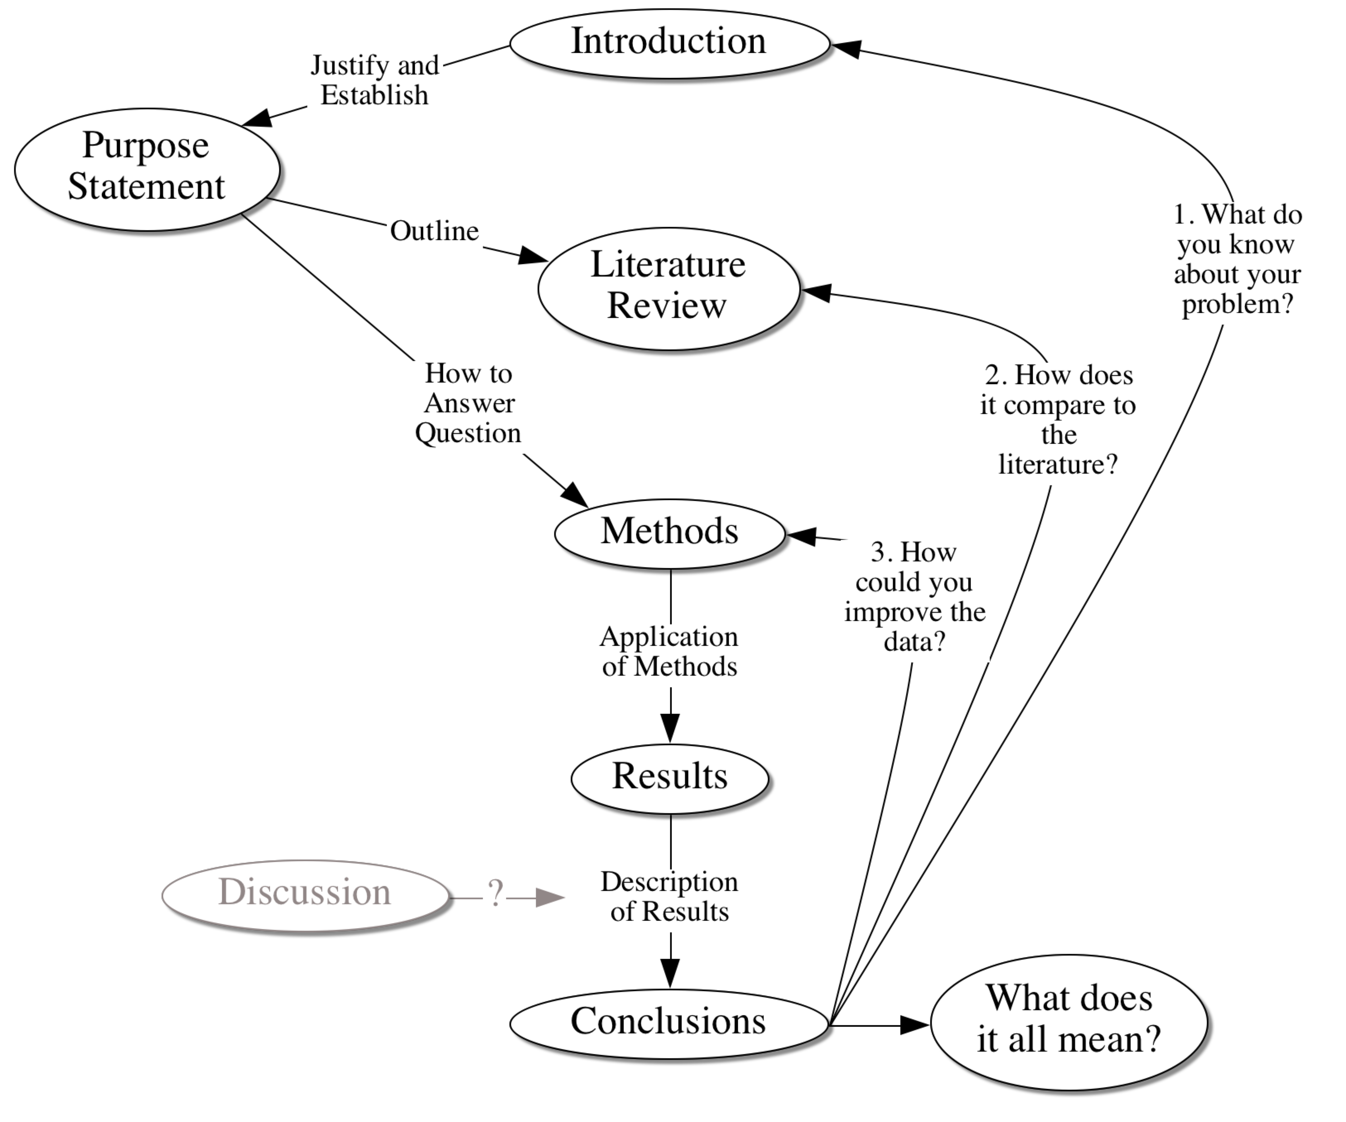
Threats to Validity

Slide 40
Validity and Proposals
In a thesis proposal you must talk about delimitations and limitations
Delimitation is the circle you draw around your study (parameters within which you work).
Limitations are the things that might impact the interpretation of the results (validity).
In doctoral research the expectation is that you reduce the limitations as much as possible.

Slide 41
Qualitative Validity—Generalizability
Many qualitative researchers feel that quantitative research ideas about validity make no sense in qualitative research.
A different approach is to gather as much data as possible from multiple sources (triangulation).
The more corroborating evidence there is, the more the study is trustworthy.

Slide 42
The Transition to Quantitative Creswell and Mixed Methods Design
Where do they over lap?
What do you need to know to use mixed methods?
Study designs
Exploratory—Using qualitative methods to design quantitative data collection
Explanatory—Using qualitative methods to enhance a quantitative explanation
Triangulation—Using both: quantitative methods to enhance a qualitative explanation

Slide 43
Methods Sections
How to help the reader know what you did—precisely.
Everything in the methods section is related to your problem statement. Yes, everything!
The methods section is designed to help the reader make judgements about study validity.

